Slide 1
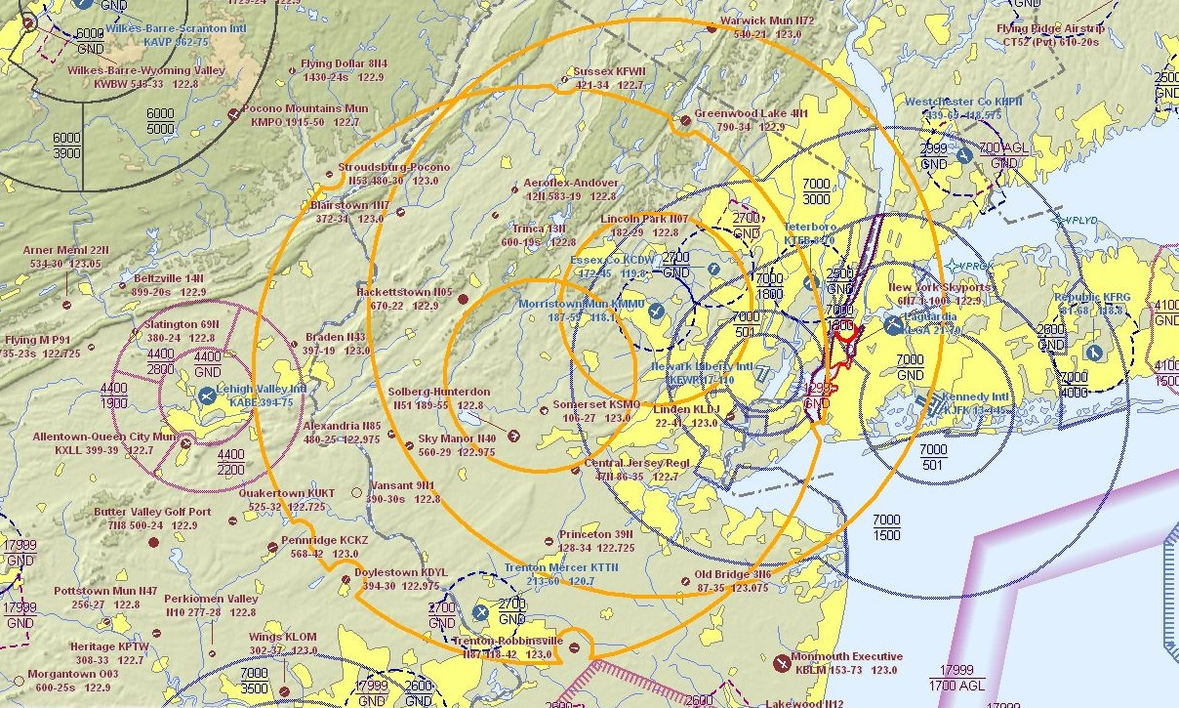
TFR activation: 4:45 PM, August 2, 2019

Slide 2
Observations from 9:15 AM to 7:23 PM
233,069 individual aircraft vectors
2,744 unique aircraft making 3,808 distinct flights
75,059 vectors from general aviation aircraft
881 unique general aviation aircraft
TFR activation: 4:45 PM, August 2, 2019

Slide 3
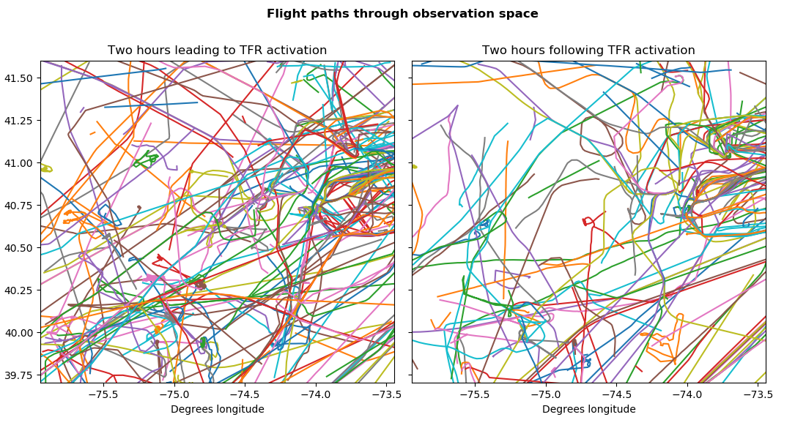

Slide 4
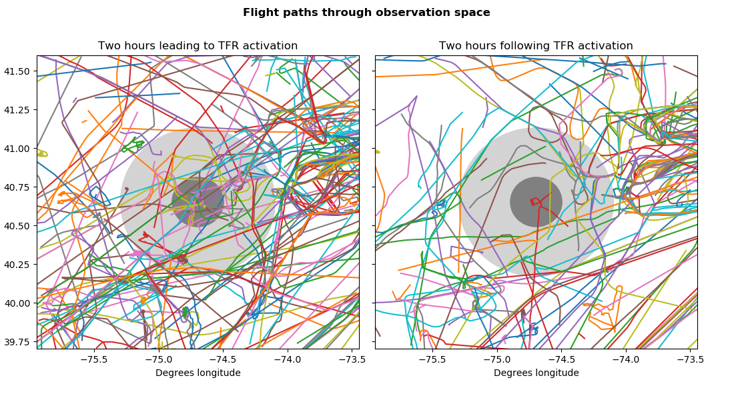

Slide 5
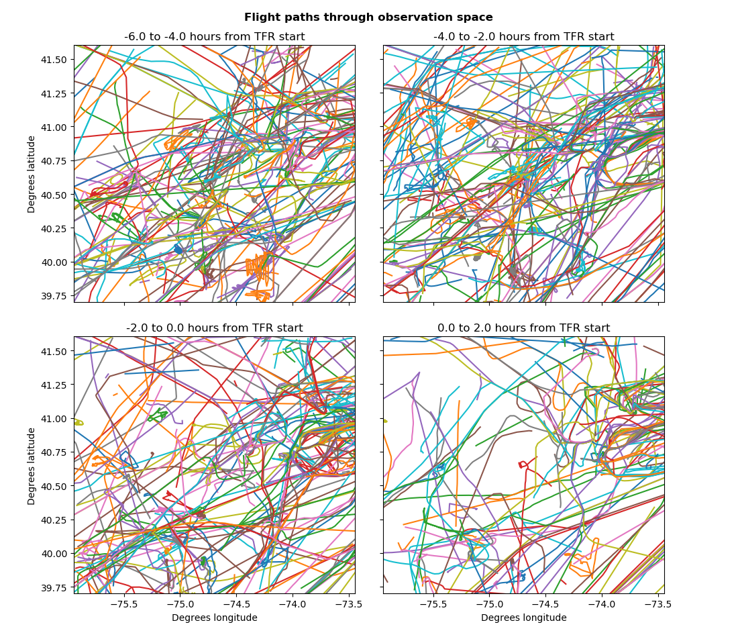

Slide 6
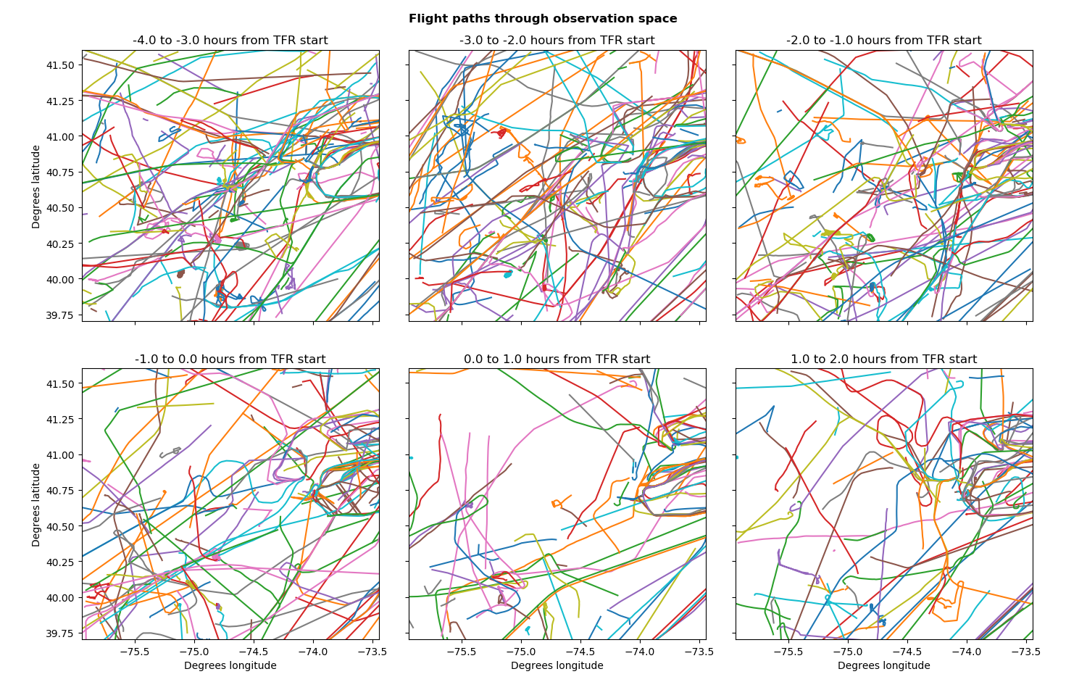

Slide 7
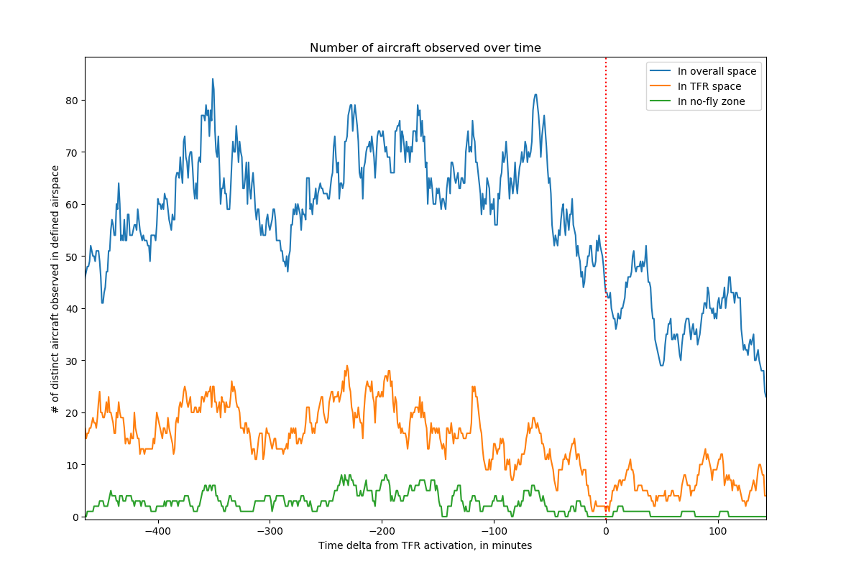

Slide 8
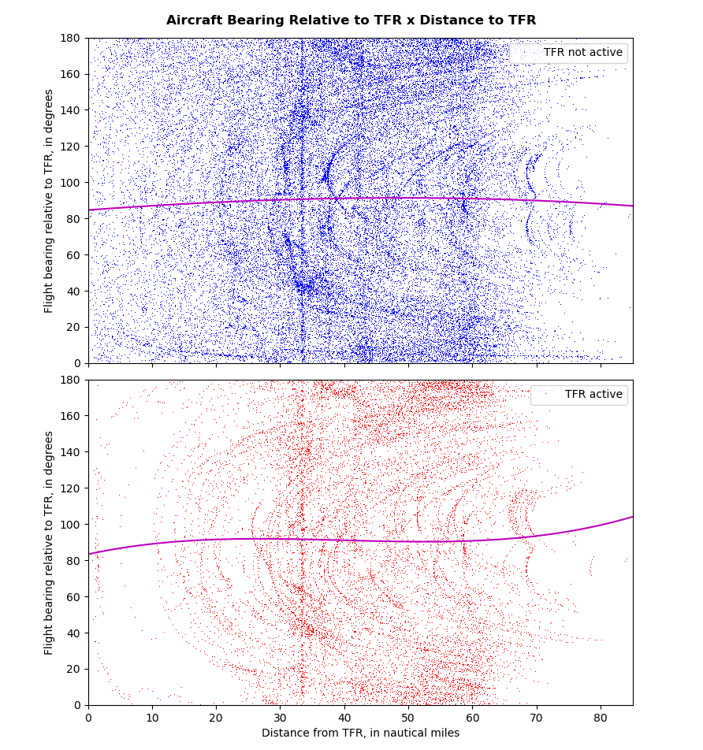

Slide 9
Relative Bearing = 84.618121 + 0.259648(nm) - 0.002164(nm²) - 0.000007(nm³)
Relative Bearing = 83.310795 + 0.773765(nm) - 0.021860(nm²) + 0.000184(nm³)

Slide 10
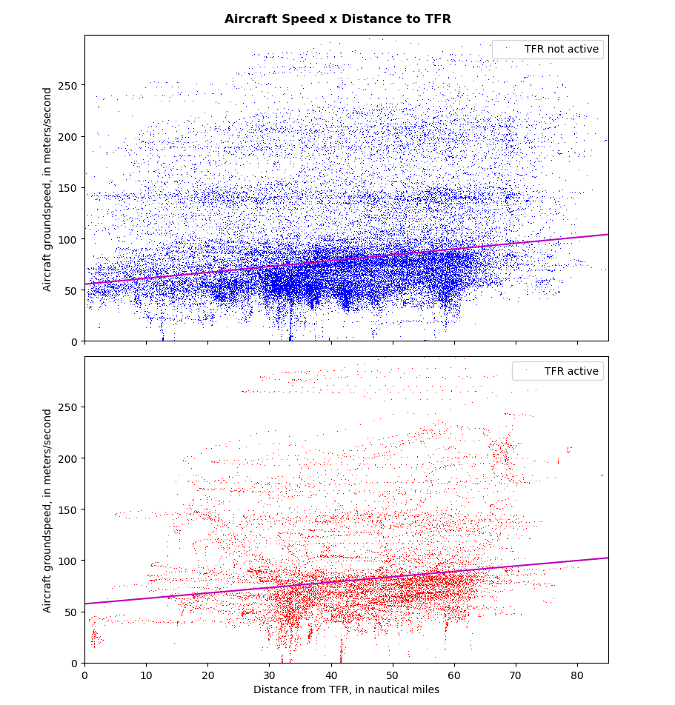

Slide 11
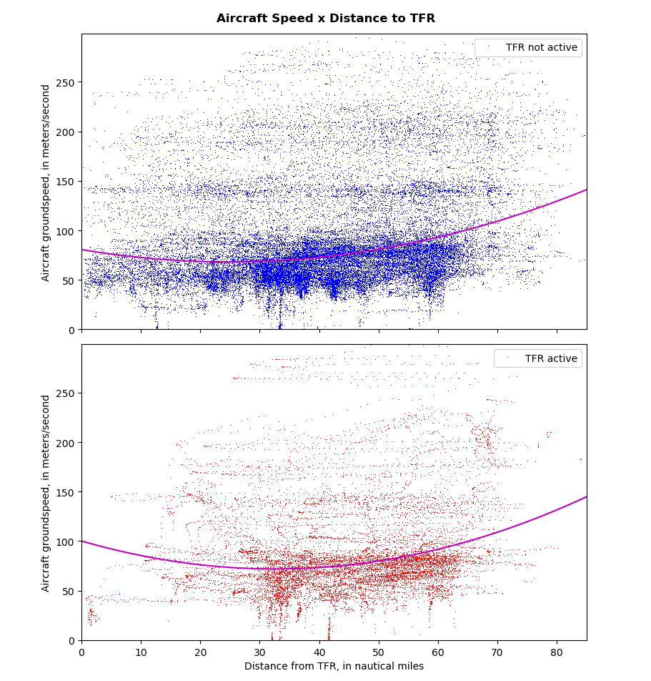

Slide 12
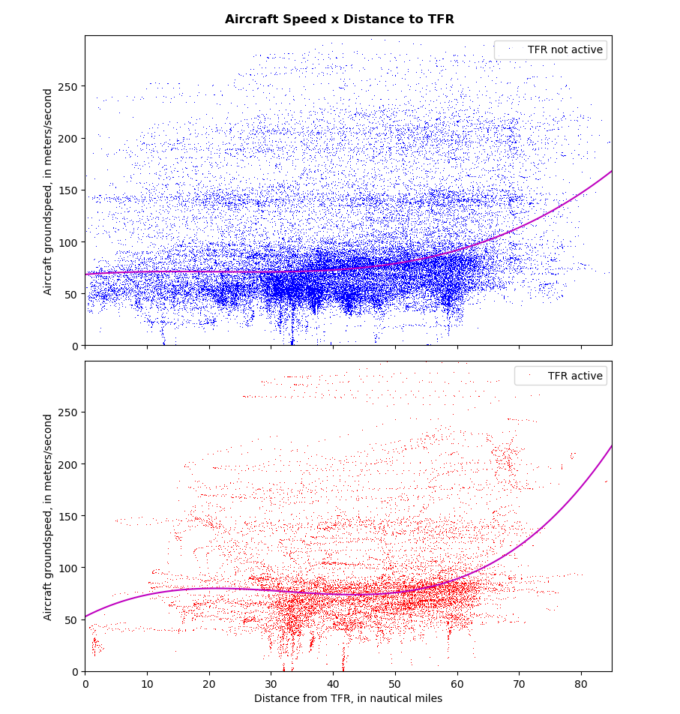

Slide 13
Groundspeed = 68.286583 + 0.466654(nm) - 0.024379(nm²) + 0.000385(nm³)
Groundspeed = 52.474069 + 3.067618(nm) - 0.107564(nm²) + 0.001109(nm³)

